Slide 1
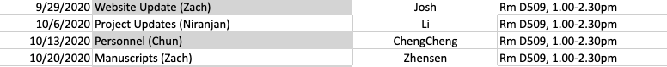
Longitudinal registration of standardized MR images (OAI)
Yin Guo
Sep 22, 2020

Slide 2
Proposed workflow of OAI longitudinal registration
Preprocessing (spatial + intensity standardization)
Segmentation of bone (femur) at baseline
Rigid registration of femur at later time points
Refine registration of vessel (popliteal artery) at later time points
An extended application: segmentation of cartilage
Validation

Slide 3
1. Preprocessing
Spatial standardization
Read dicom images and save headers
Change orientation to RAI (right, anterior, inferior)
Change laterality if knee side is right
Set origin to zero
Intensity standardization
Rescale intensity to [0,100]
Potentially: Correct intensity nonuniformity^{[1]},
edge preserving smoothing^{[2]}…
[1] Sled IEEE TMI 1998
[2] Shan Med Image Anal 2014

Slide 4
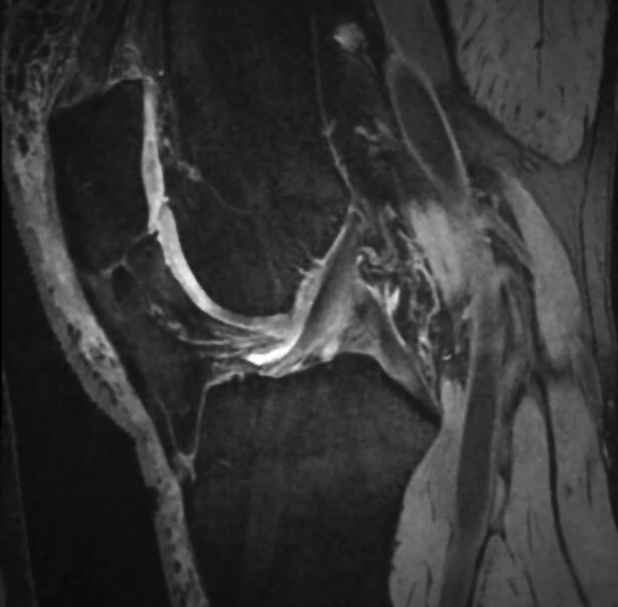


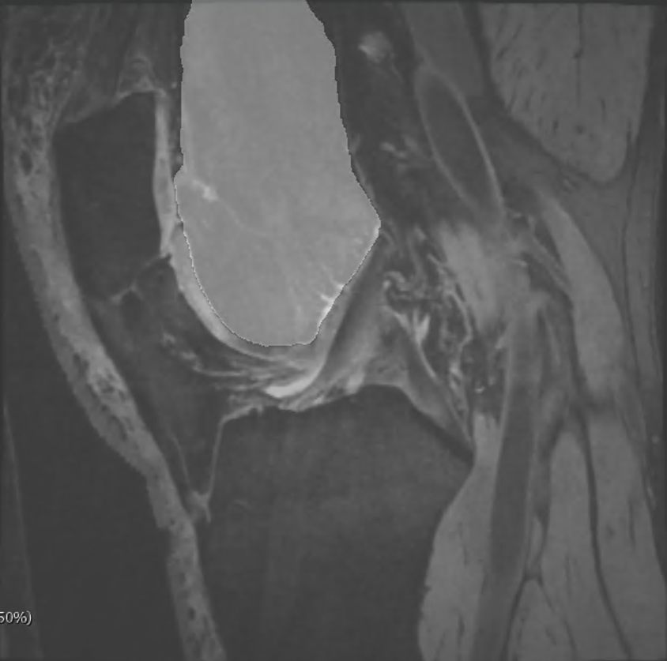
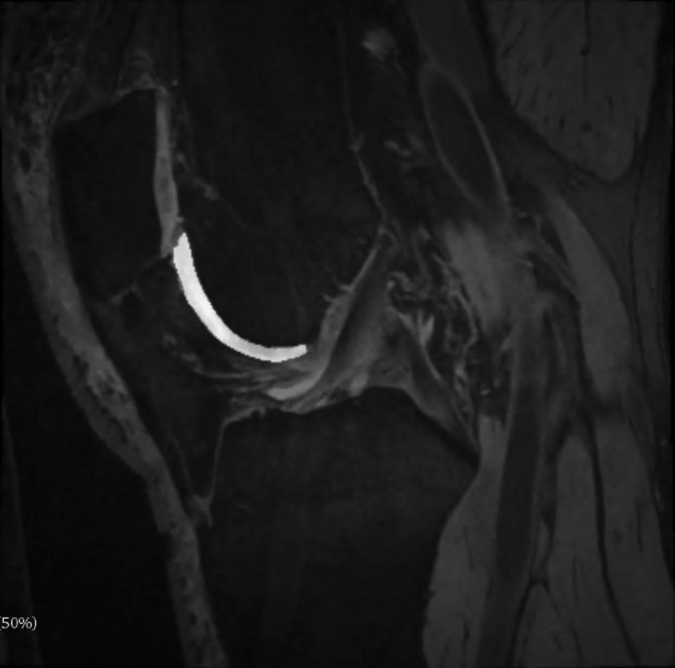
2. Segmentation of bone (femur) at baseline
Active contours, atlas-based, graph-based, machine and deep learning, and hybrid combinations…
Here, segmentation by registration
Reference image: from pyKNEEr demo
Registration framework: elastix & transformix
Femur mask
Cartilage mask
50% fm blend
50% cm blend
Bonaretti PLoS One 2020

Slide 5
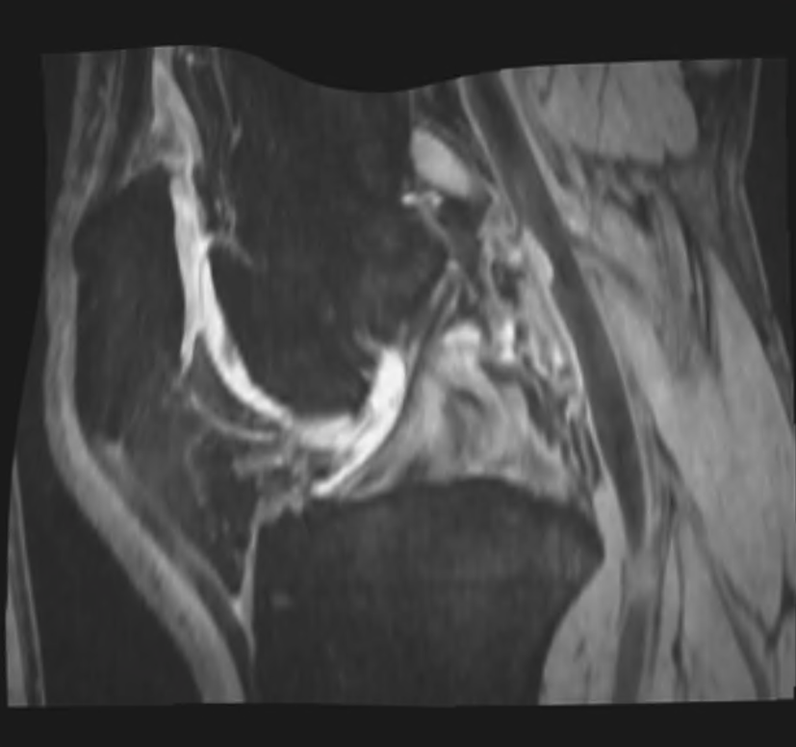
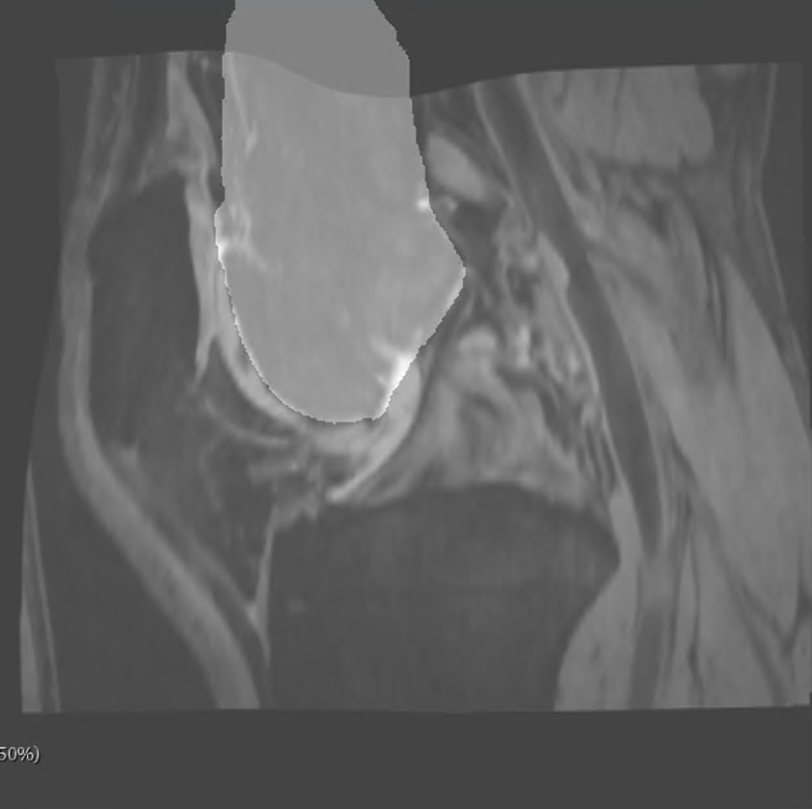
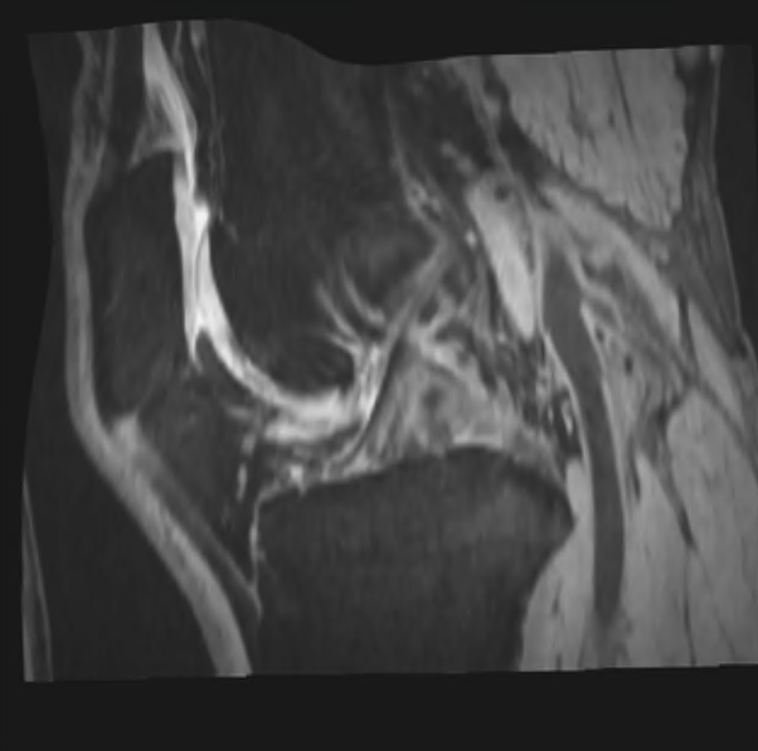
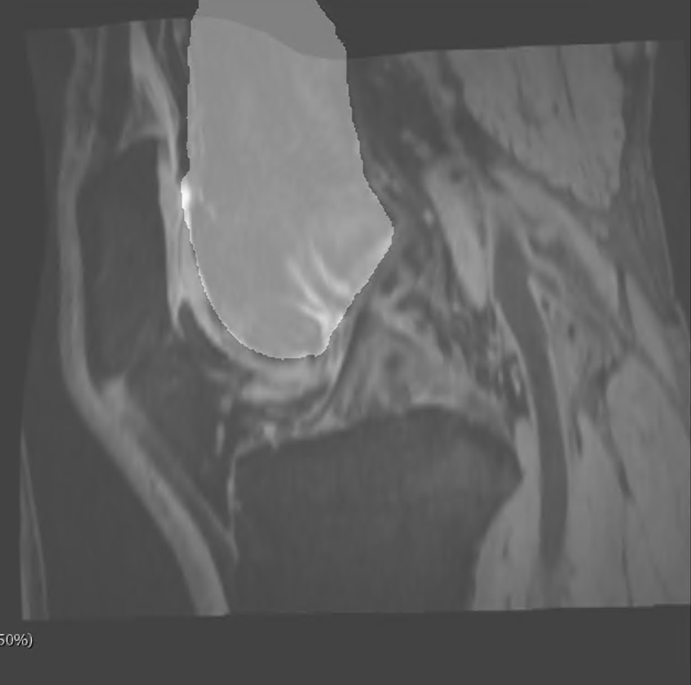
Segmentation by registration
Step 1 Register moving to reference image
In our case, moving: baseline scan (L&R) of each OAI subject
rigid + similarity + spline
Registration mask: r fm (15 pixels dilated)
reference (pyKNEEr)
9404954L
baseline
50% r fm blend
9404954R
baseline
50% r fm blend

Slide 6
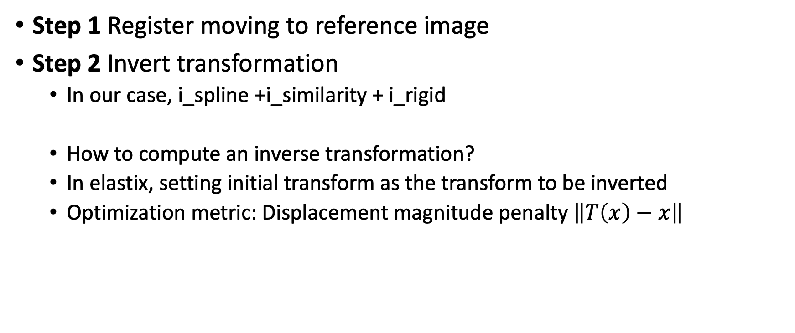
Segmentation by registration
Step 1 Register moving to reference image
Step 2 Invert transformation
In our case, i_spline +i_similarity + i_rigid
How to compute an inverse transformation?
In elastix, setting initial transform as the transform to be inverted
Optimization metric: Displacement magnitude penalty $\left\|T\left(x\right)−x\right\|$

Slide 7
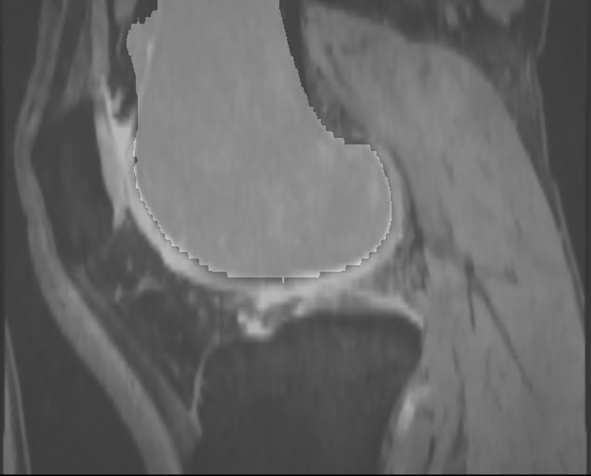
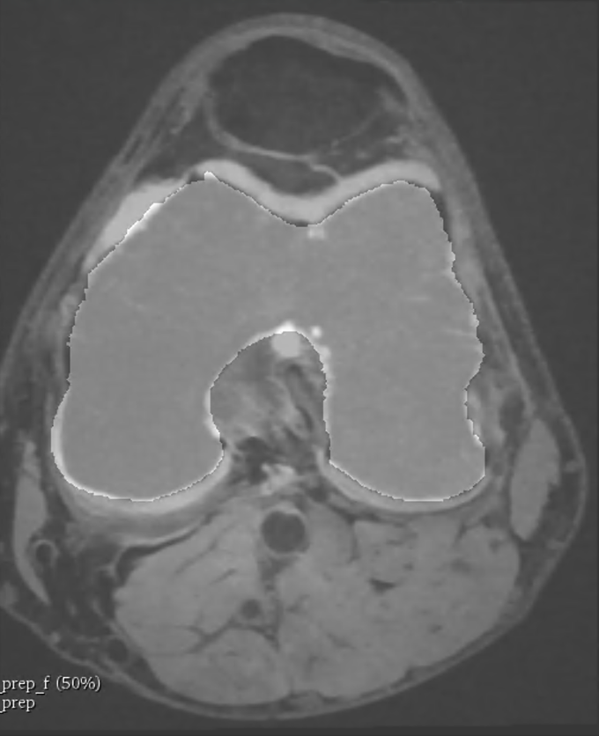
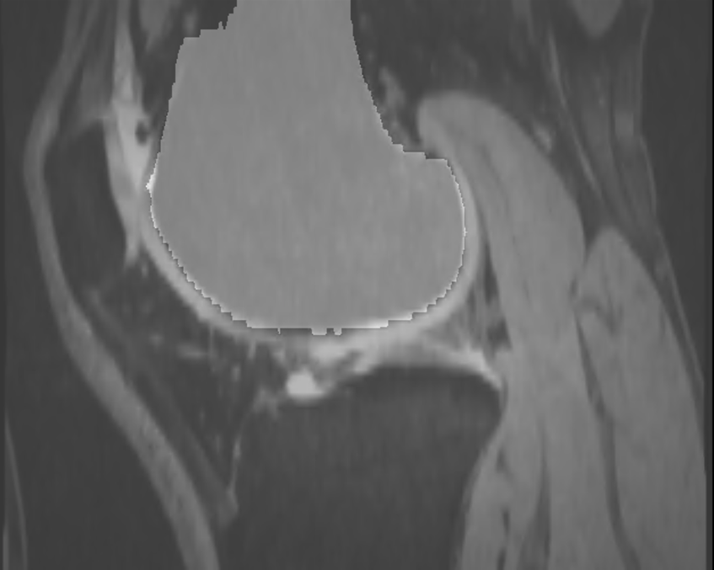
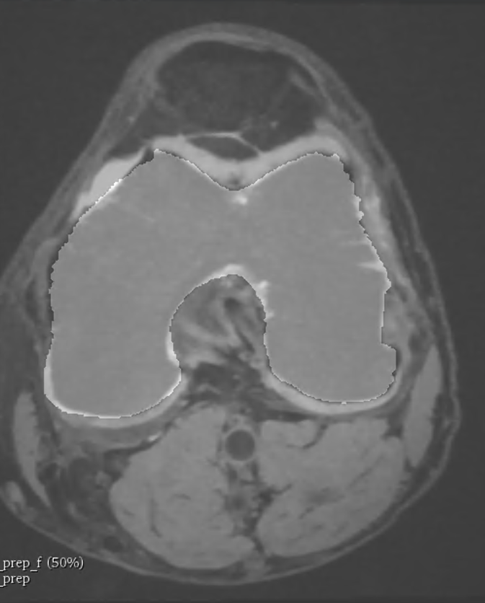
Segmentation by registration
Step 1 Register moving to reference image
Step 2 Invert transformation
Step 3 Warp reference mask to moving mask
Level set rather than binary mask: reduce aliasing artifacts
Whitaker IEEE VVGS 2000
9404954L
baseline
50% warped r fm blend
9404954R
baseline
50% warped fm blend
Notes:
Inverted transformations are applied to the mask of the reference image to obtain the mask of the moving image. This filter implements a surface-fitting method for estimation of a surface from a binary volume. This process can be used to reduce aliasing artifacts which result in visualization of binary partitioned surfaces.

Slide 8
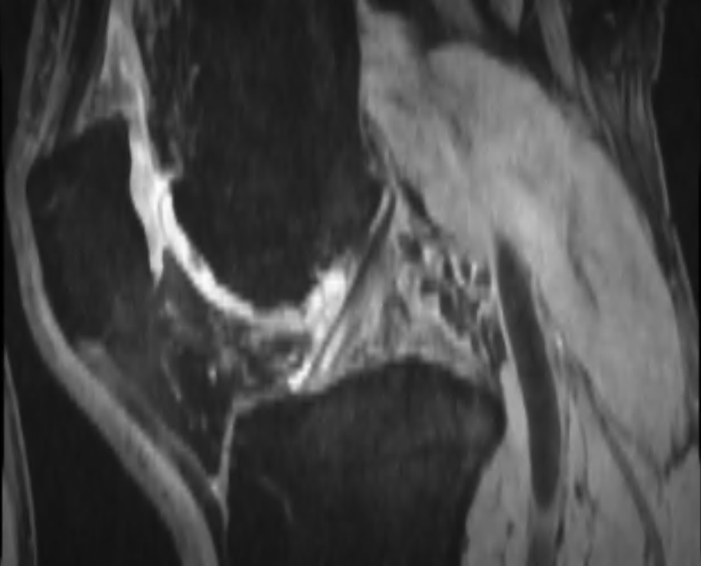
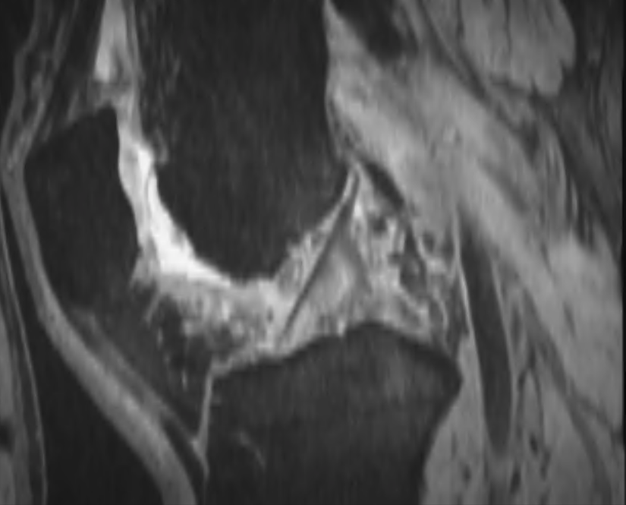
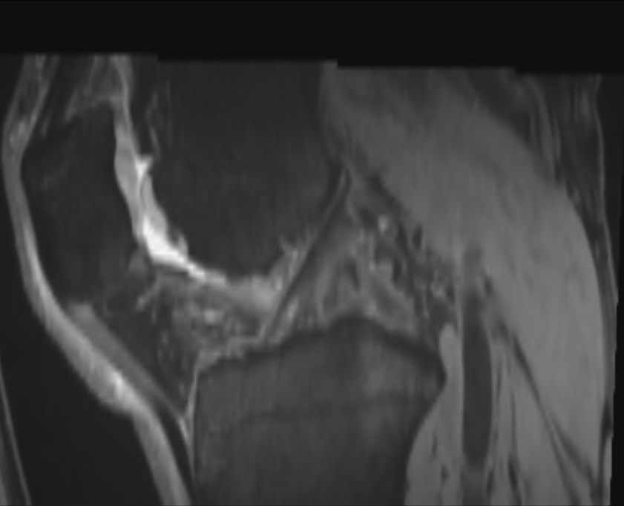
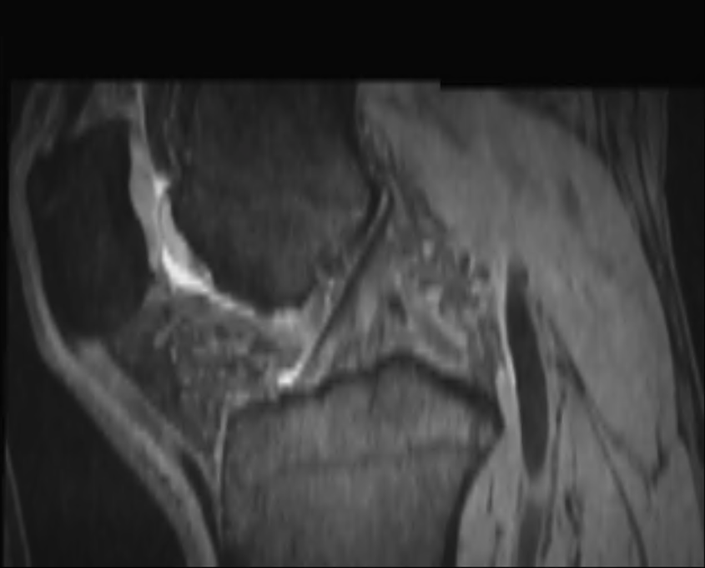
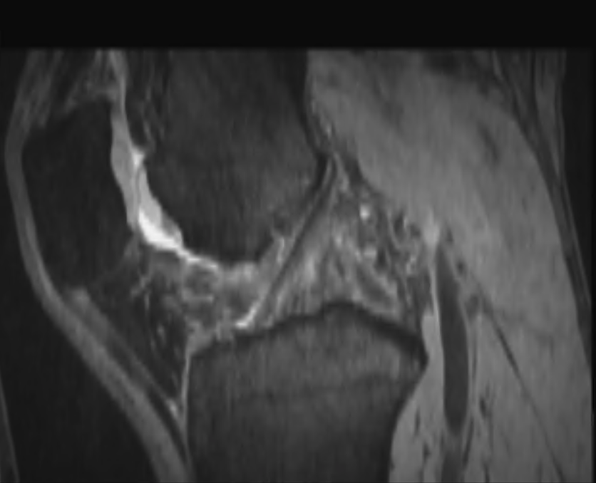
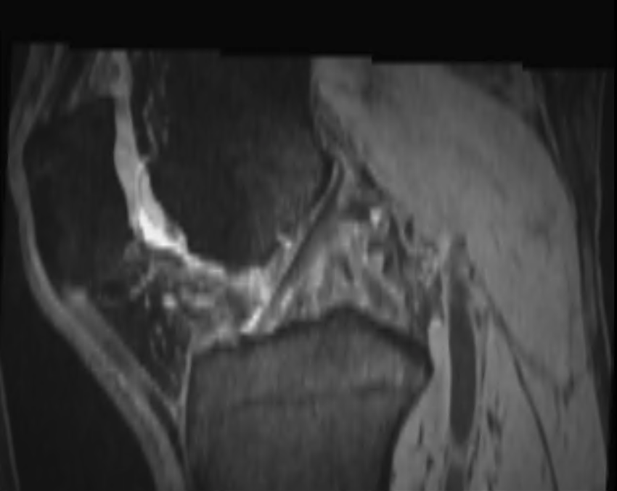
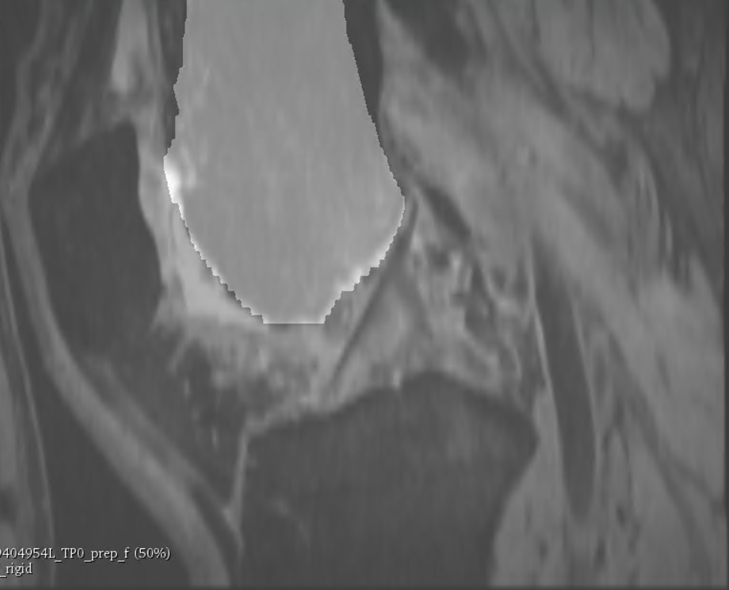
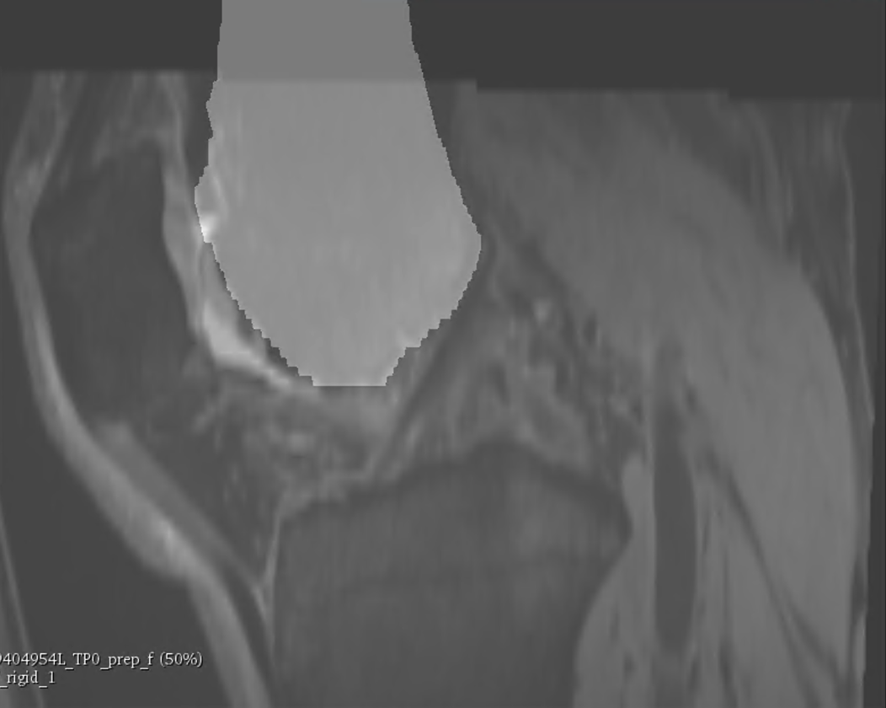
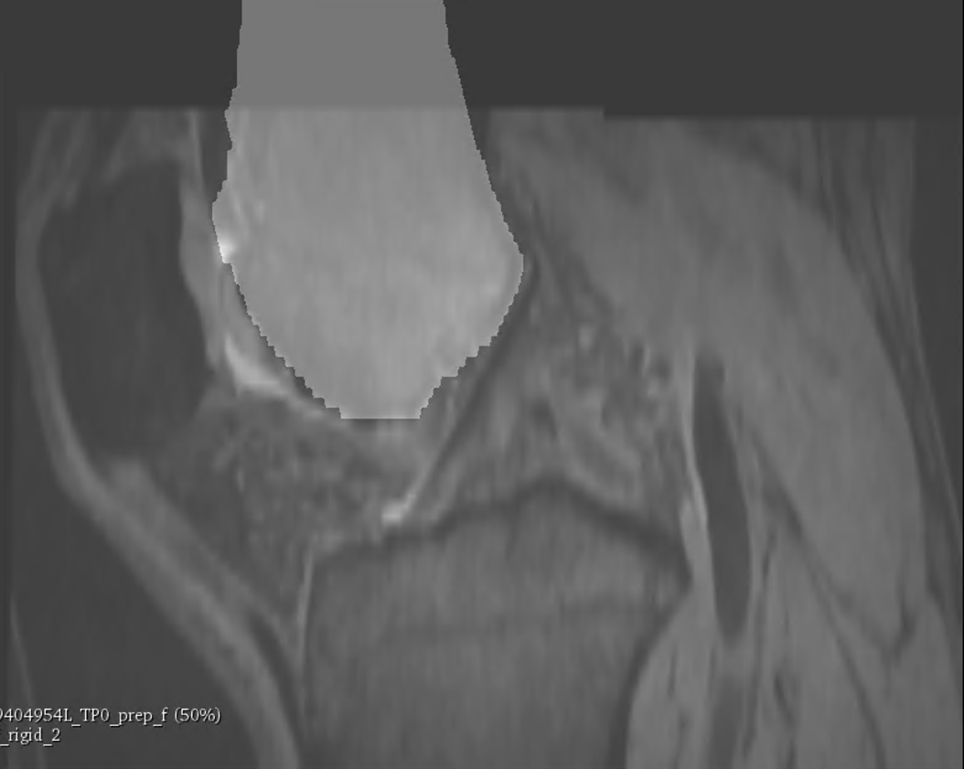
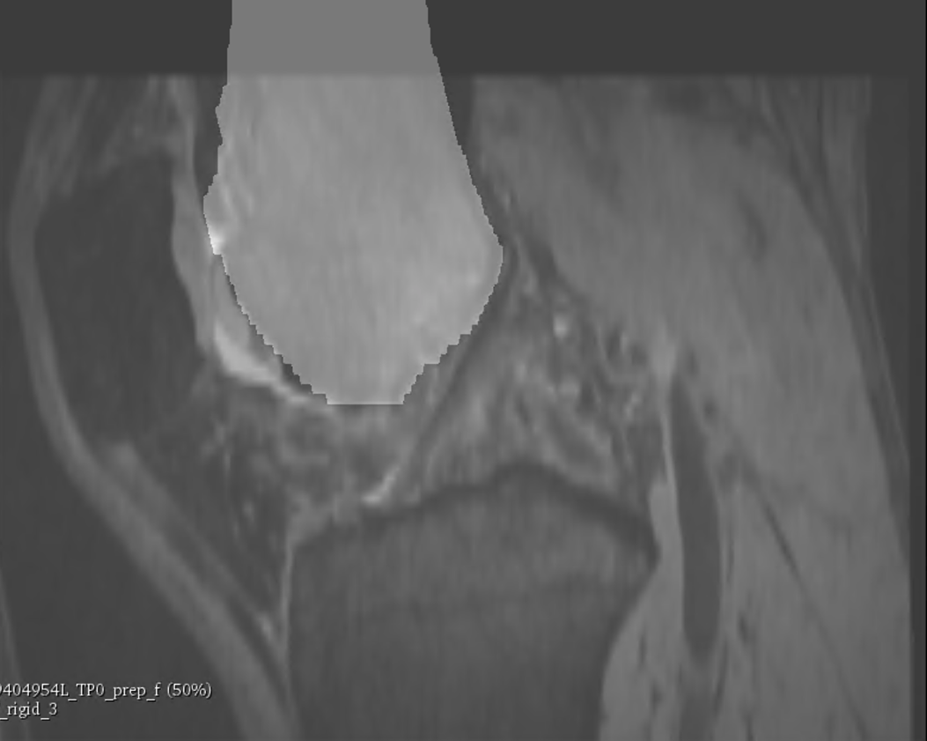
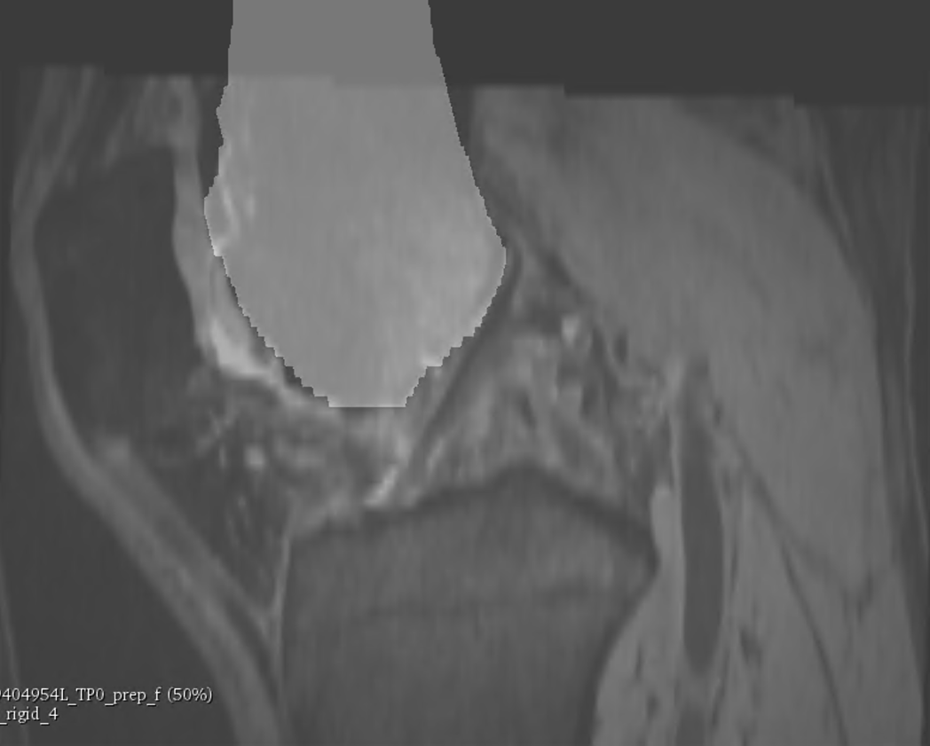
3. Rigid registration of femur at later time points
Registration mask: baseline femur (segmented in 2, 15 pixels dilated)
reference
(baseline)
9404954L 50% r fm blend
12mo
24mo
48mo
72mo
96mo

Slide 9
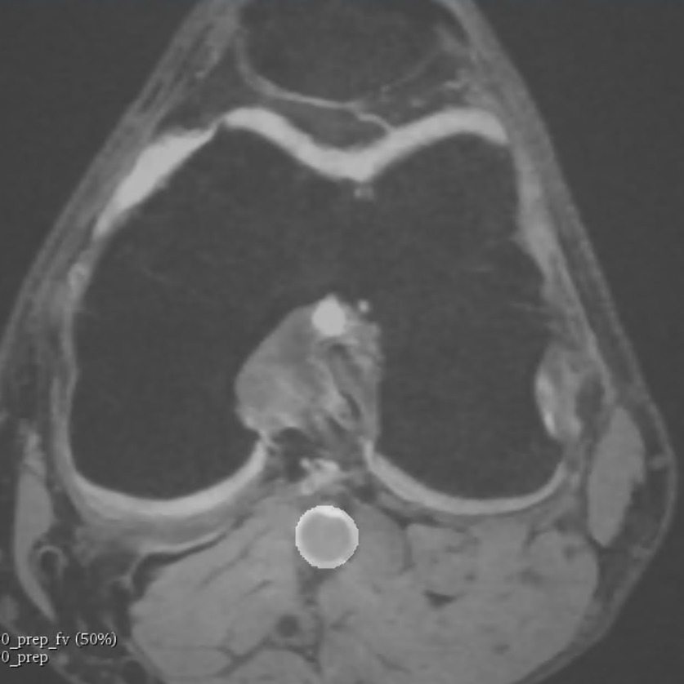
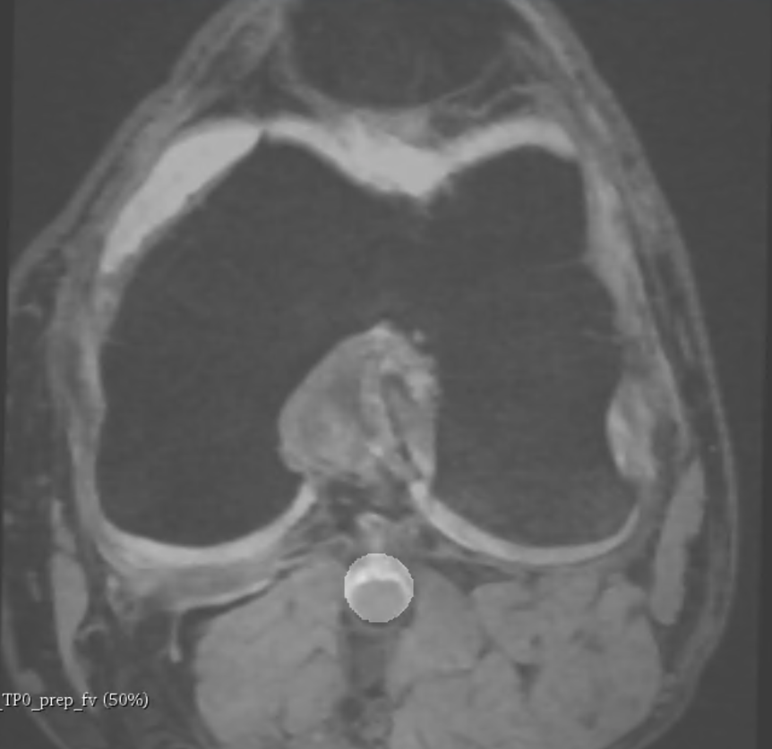
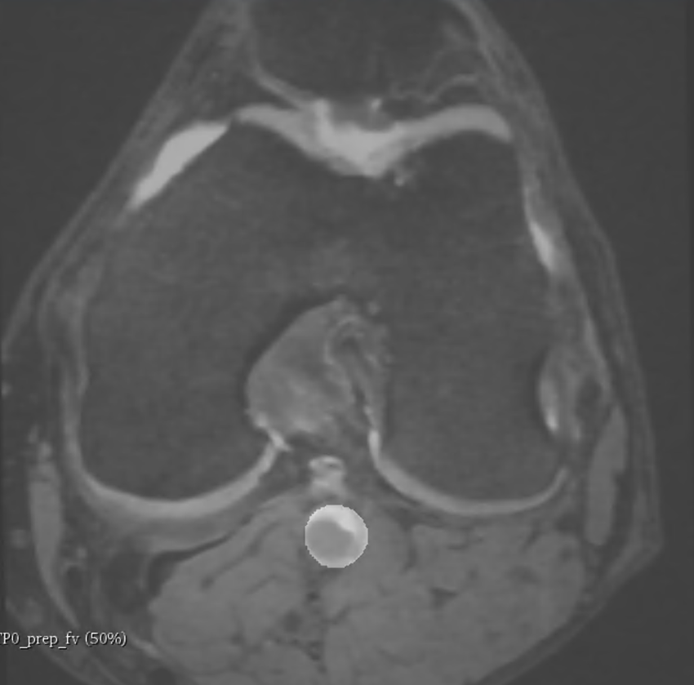

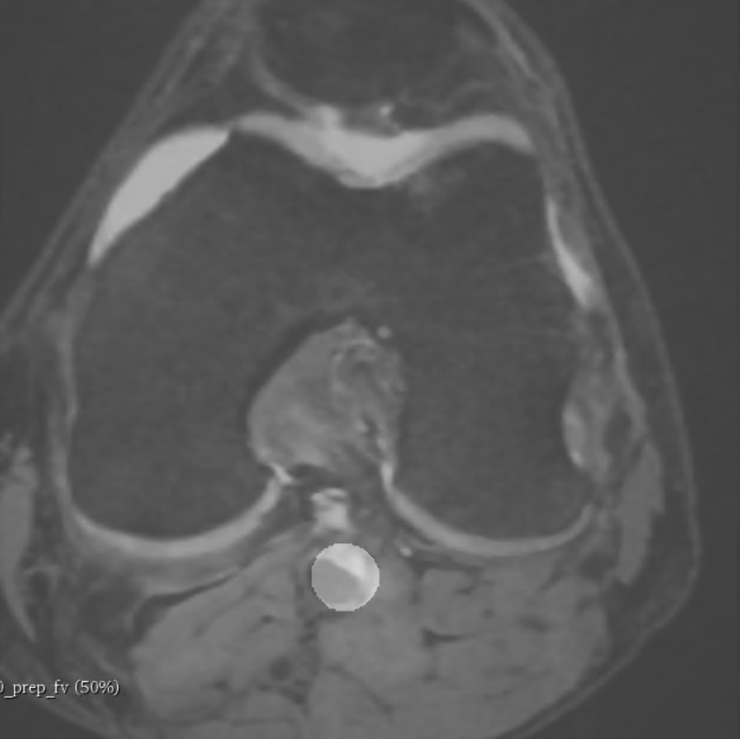
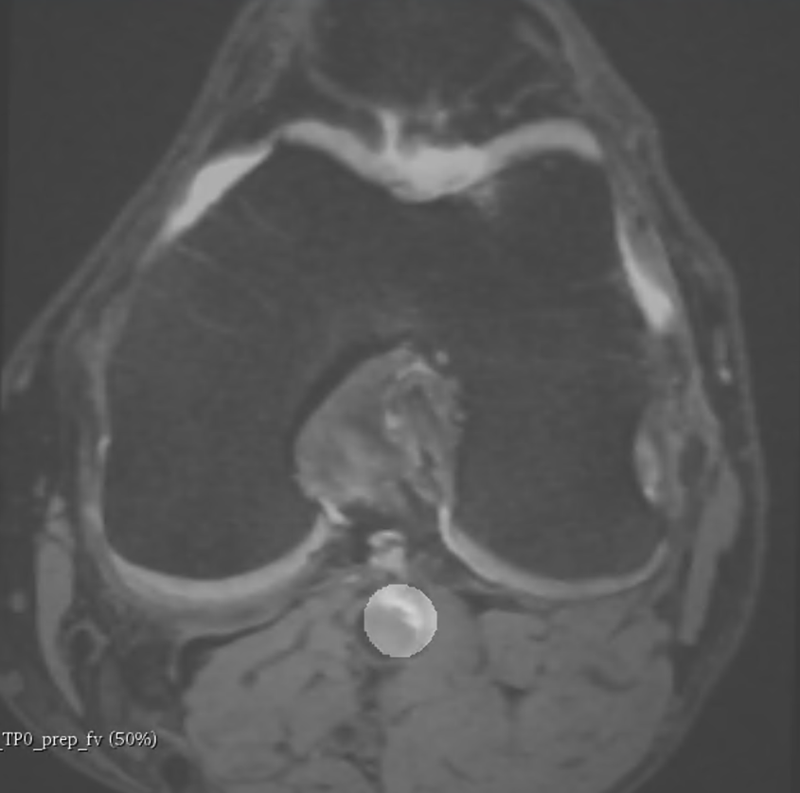
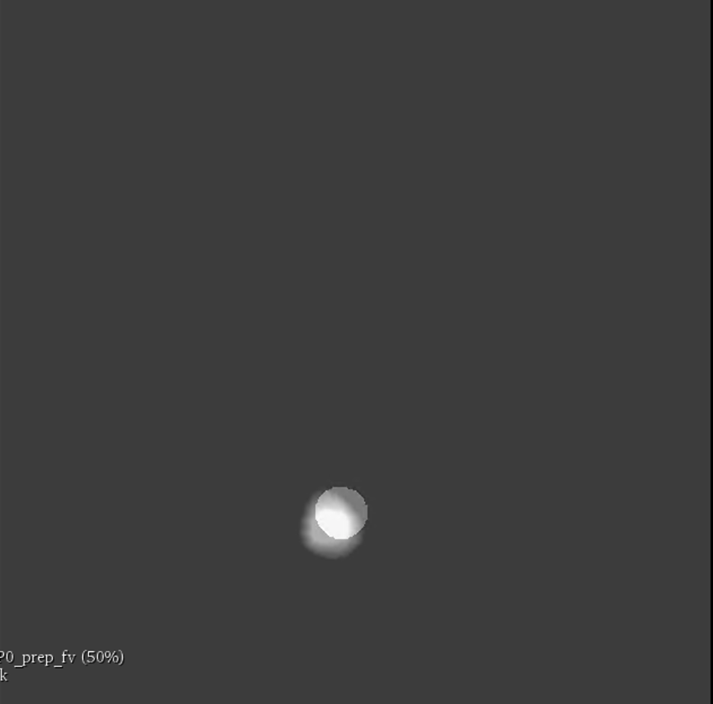
How about the vessel?
9404954L 50% r vm blend
baseline
12mo
24mo
How to quantify?
Dice score (intersection over union)
FRAPPE baseline vessel mask v.s. transformed (rigid) TPx vessel mask
48mo
72mo
96mo
96mo

Slide 10
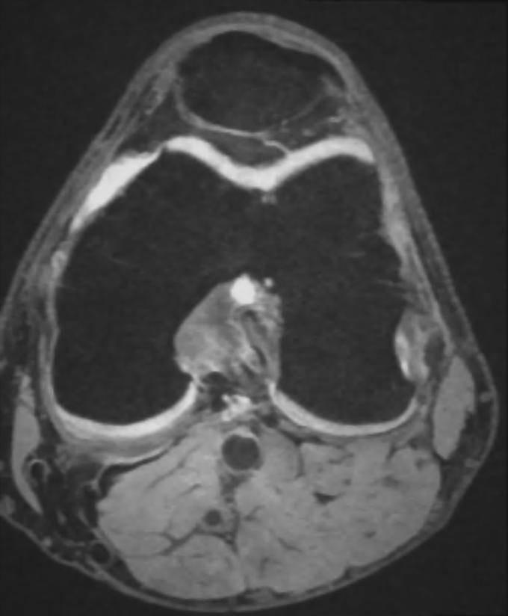
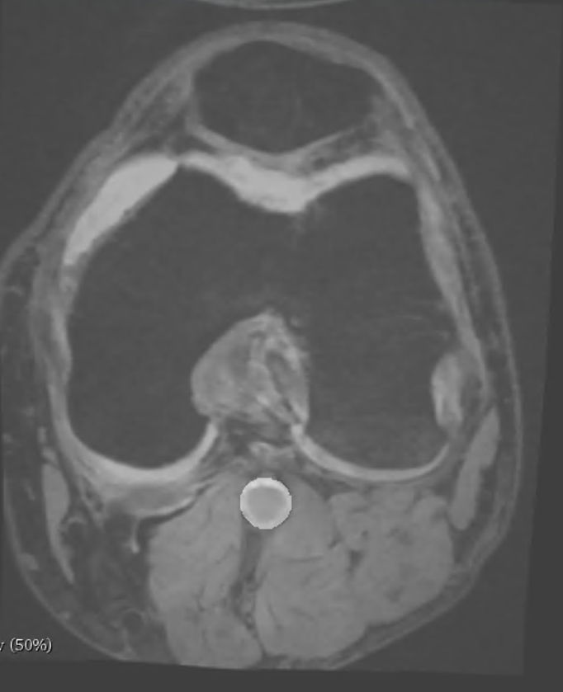
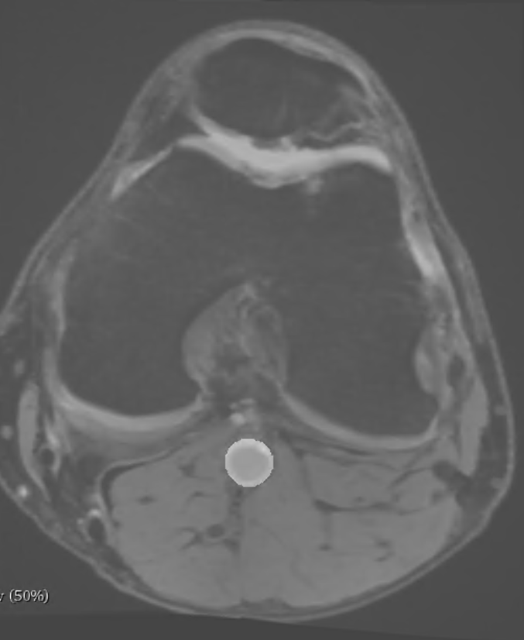
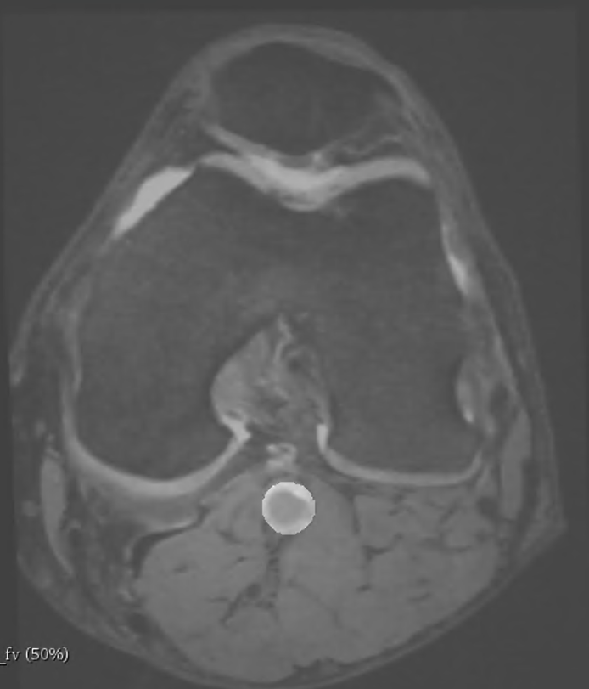
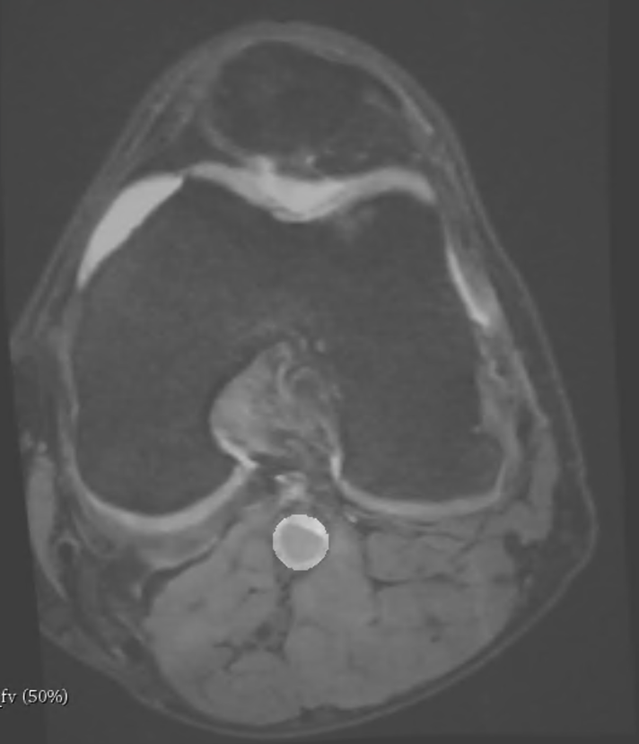
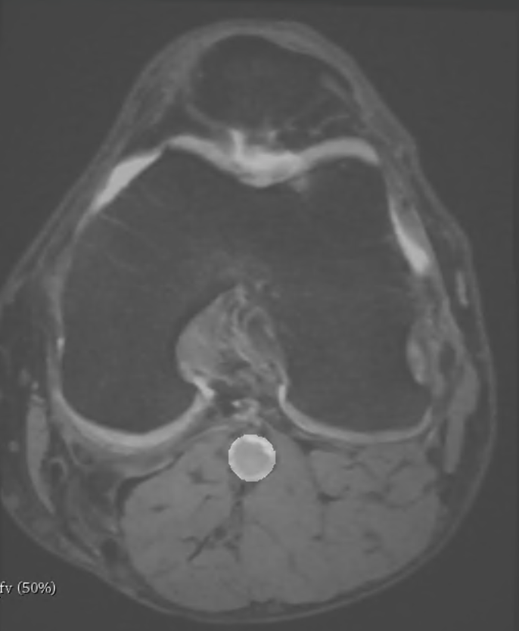
4. Refine registration of vessel at later time points
Method 1 do nothing
Also transform FRAPPE centerlines and vessel wall contours
Method 2 non-rigid transform of the vessel
Initial transform: rigid (transformed in 3)
Registration mask: baseline vessel (from FRAPPE, 15 pixels dilated)
9404954L
50% r vm blend
baseline
12mo
24mo
48mo
72mo
96mo

Slide 11
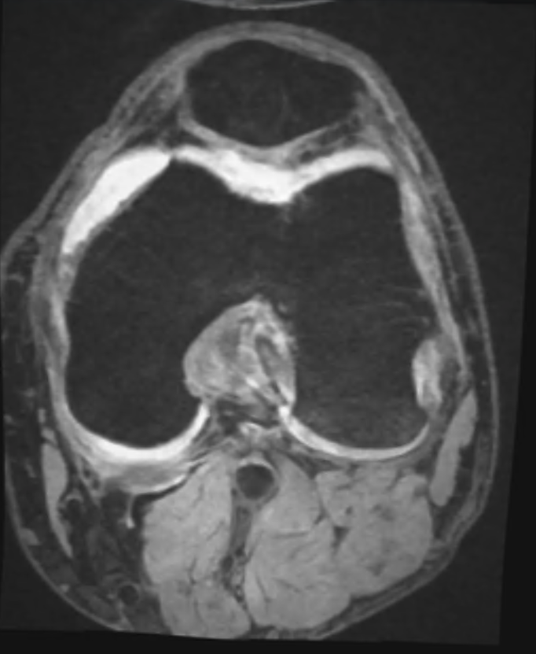
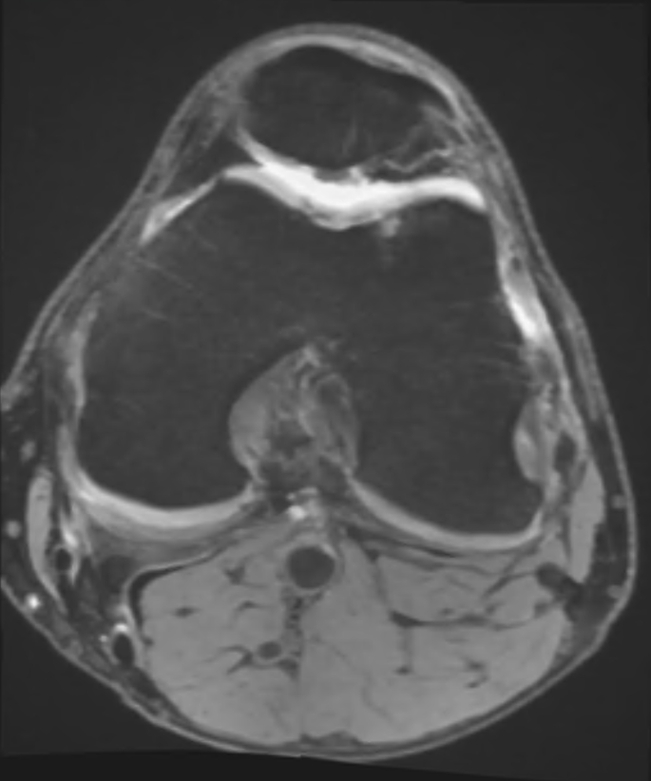
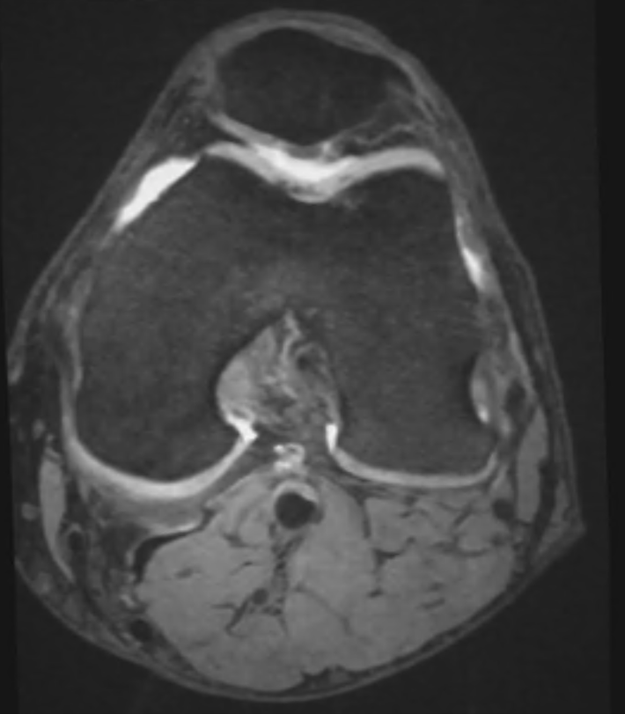
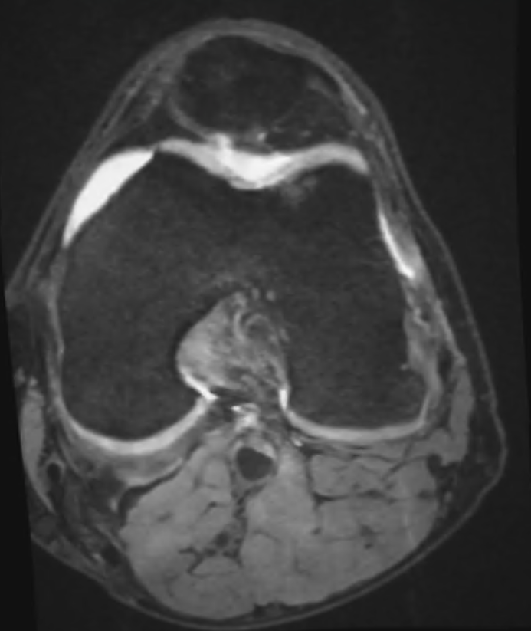
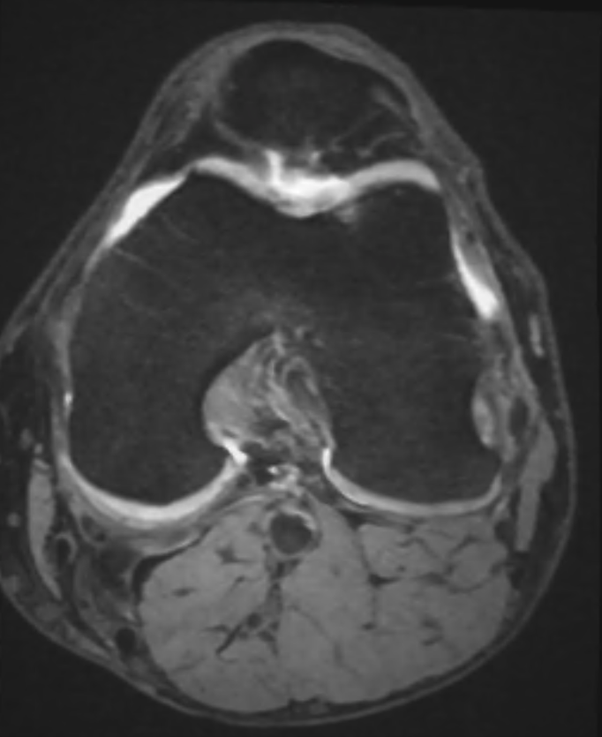
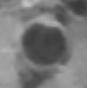
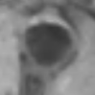
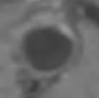
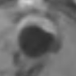
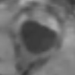
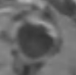
baseline
12mo
24mo
48mo
72mo
96mo

Slide 12
Also, segment by registration!!!
With method 2 (vessel registration refinement), inversely, we can directly segment outer wall contours at later time points!!!
Step 1 Register moving to reference image
Femur rigid + vessel spline
Step 2 Invert transformation
i_spline + i_rigid
Step 3 Warp reference mask to moving mask
Baseline ➡️ TPx vessel mask
Dice score: segmented TPx vessel map v.s. FRAPPE TPx vessel map

Slide 13
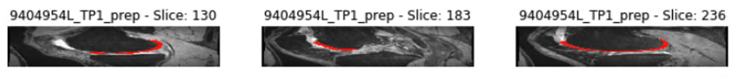
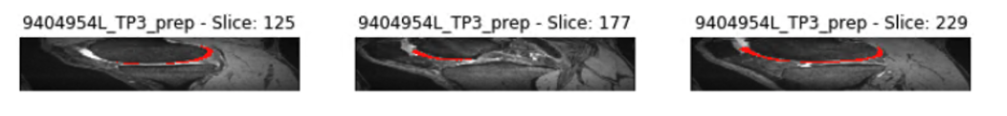
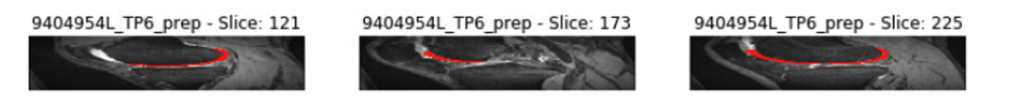
5. An extended application: cartilage segmentation
Segmentation by registration

Slide 14

Validation
5 cases, L&R, all time points available ➡️ 58 instances
4 instances totally fail (at rigid, excluded)
Dice score 1 (FRAPPE baseline vessel mask v.s. transformed (rigid) TPx vessel mask): 0.673
Dice score 2 (segmented TPx vessel map v.s. FRAPPE TPx vessel map, 0.816
9911265R 96mo

Slide 15
Future thoughts
Does register femur rigidly suffice?
What about tibia?
Does non-rigid vessel registration tamper vessel feature?
If not, how to validate?

